Slide 1

AirCraft Risk Analysis
By Michelle Chekwoti

Slide 2
Overview
The company is going to expand into new industries to diversify its portfolio, and they are interested in Aircraft, focusing on the purchasing and operating for commercial and private enterprises. This analysis is to look at the potential associated with aircraft in order to pinpoint the lowest risk for the company to start this new business endeavor.

Slide 3
Business Understanding and Goals
We want to identify aircraft with the least risk to the company.
This means we need to identify aircraft that has the lowest risk of accidents and failure.
However, they are many factors that go into this including: The type of aircraft, its model, make, its air carrier, the weather and more.
This will help the investors pick an aircraft with the least risk of damage and loss of investment.

Slide 4
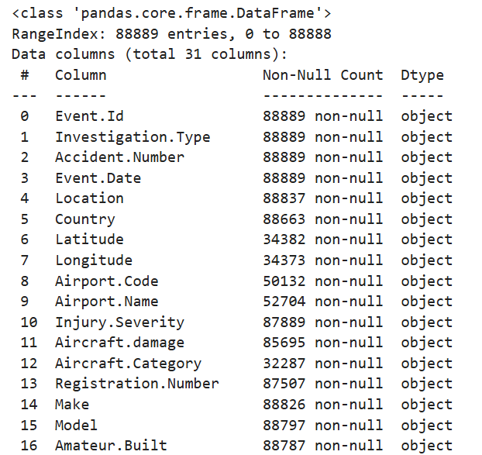
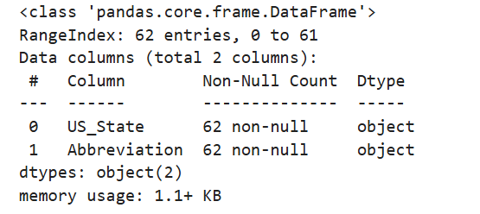
Data Understanding
Data Source: Using data from Kaggle’s Aviation Accident Database & Synopses, up to 2023. This has 2 datasets one with the aircraft data and another with states and abbreviations.
With information on the aircraft, possible causes of failure, carrier and location of the accident.
Data quality and limitations: The data has multiple missing values in it’s the categorical columns.
4

Slide 5
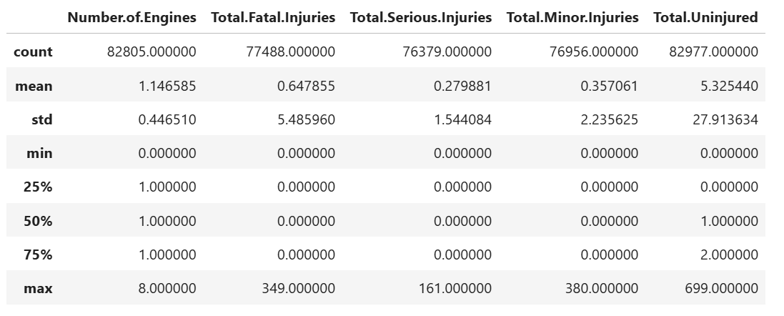
Data Understanding
Descriptive statistics on numerical columns:
We note from the descriptive statistics that the max number of engines is 8, however, the average is 1. This could depend of use of the aircraft or even load which could affect its performance.
The max number of Fatal injuries is 349 but on average it is 0.64. This shows the majority of Aircraft is safe with only injuries ranging from 0.64 at Fatal to 0.35 at Minor.
The average number of Uninjured is much higher than that of the Injuries and therefore we can assume that Aircraft in general is considered to be a safe form of travel and good for the company.
5

Slide 6
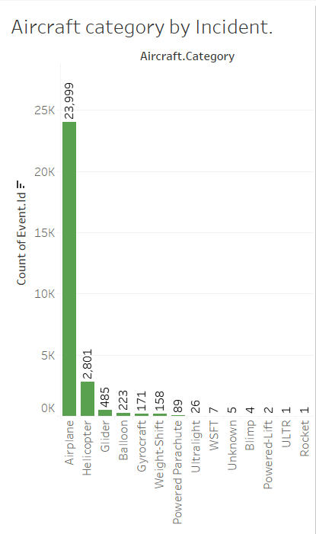
Data Analysis
As shown the aircraft with the highest amount of risk due to incident is the Airplane with 23999.
Second only to the helicopter, at 2801. This means that the most risky aircraft in the industry is the airplane even more so than the rocket which is the least.
This also means that it is likely to be the most frequently used aircraft.

Slide 7
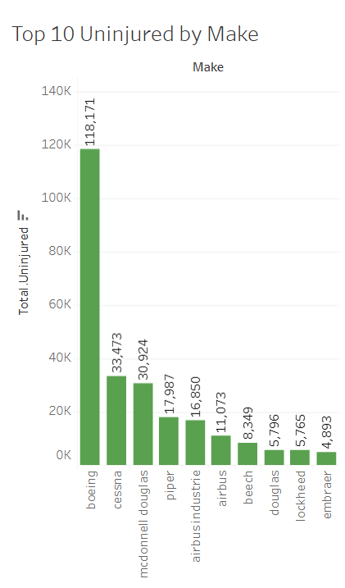
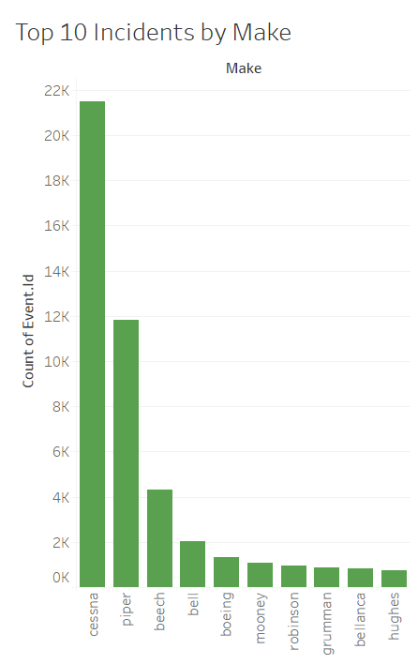
Data Analysis
Looking at the top 10 incidents and the total number of uninjured by Make.
We can see that the highest number of incidents are seen by the Aircraft make Cessna this means they have a history of creating aircraft that has a high number of accidents and incidents.
The highest number of Uninjured by Make is Boeing , this shows that although they are listed to have a high number of incidents, they also create strong planes that can leave a large number of survivors and therefore is less risky.

Slide 8
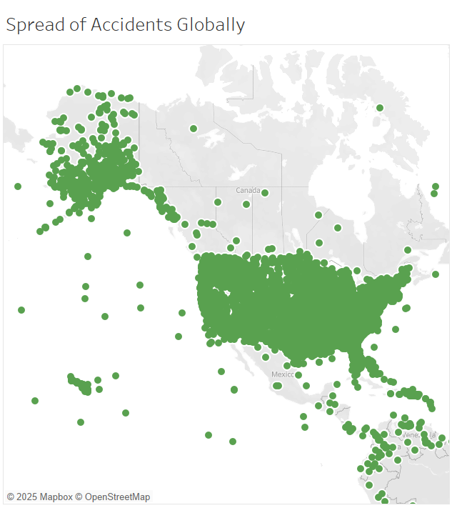
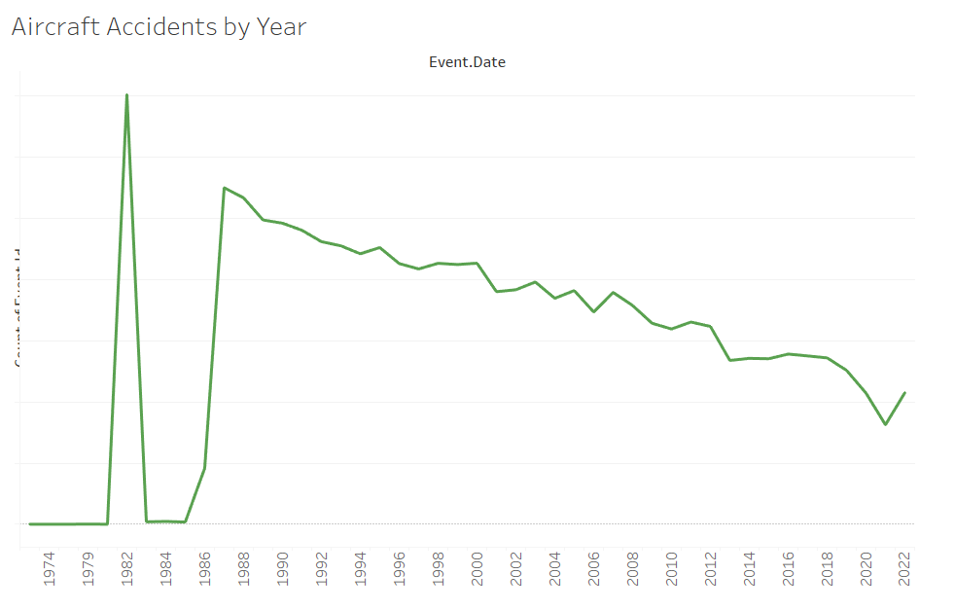
When looking at the spread the majority if aircraft incidents are located in the USA and if the company is located here further research on the causes will need to be established.
When looking at the year you will notice that the number of accidents has reduced overtime showing that safety measure in aircraft has increased.

Slide 9
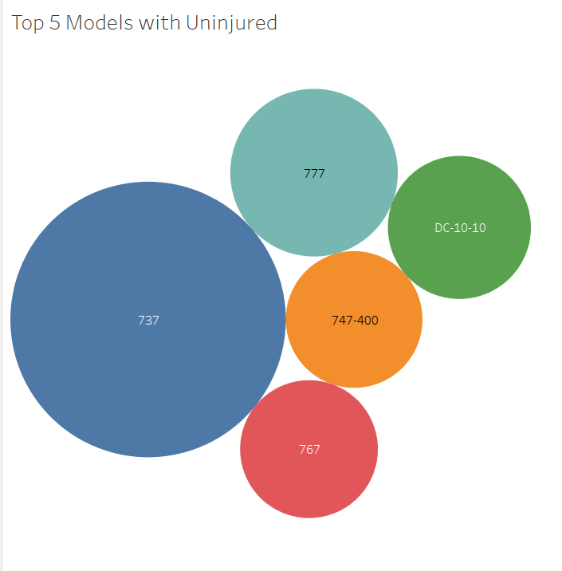
Answer
When looking at specifically airplane and filtering for the h Airplane the boeing 737-732 has the highest number of uninjured and so it is considered to be the strongest airplane in the business and therefore the lest risky.

Slide 10
Recommendations
If possible, more away from airplanes are they are found to have the highest number of aircraft accidents.
Boeing is considered to have the highest number if uninjured in the industry and so investing in their aircraft is recommended. Specifically, the boeing 737-732 .
The number of aircraft related accidents has reduced over time indicating that aircraft regulations and machinery has become less risky and safer to invest in so the company can focus on aircraft as planned.
Further research is needed to identify why the USA has the highest number of aircraft accidents especially if they are located as company in the country
10

Slide 11
Next Steps
Look into models under Boeing and locate the preferred model that is available .
Research into company needs ; what exactly is the aircraft to be used for whether commercially, personal, business/ executive or cargo as this will largely influence the model selection.
Look into pricing dependent on model and if possible to rent the required aircraft.
Model required
Company needs
Pricing
11

Slide 12
Thank you
Any Questions?

